Slide 1
Efficient Attendance Monitoring Using
AI-Based Face Detection
Nicholas Marshall, Nivedita Prabhu, Frank Diabour, Matthew Willingham, Ayodeji Adeogun

Slide 2
Group Members
Nivedita Prabhu
Nicholas Marshall
Ayodeji Adeogun
Frank Diabour
Matthew Willingham
Computer Science, Mathematics, Software Engineering
Computer Science
Computer Science, Software Engineering
Computer Science
AI/ML, Prototyping
Computer Science
Software Engineering

Slide 3
OverVIEW
Introduction
Motivation
Impacts
Project Implementation
Model Training and Image Augmentation
Data Collection
Diagrams
Database System
Website UI
Demo+Summary

Slide 4
Introduction
AI has significantly transformed education, workplace management, and security.
Proposal: An AI-driven attendance system using computer vision and machine learning for real-time face recognition.
Utilizes: A deep learning model is employed to detect faces and match them against a stored database.
Where: Attendance is recorded automatically once a match is confirmed.
Provided: A web interface allows Professors to review and manage the generated attendance data.
Ayodeji Adeogun

Slide 5
Motivation
Why This Project?
Tracking attendance in large classrooms is challenging and error-prone.
Professors struggle with accuracy, leading to misrepresentation.
Traditional methods are slow, inefficient, and easily manipulated.
Our intent is to generate a fast paced and accurate solution to this issue by, creating a seamless attendance tracking method for large classrooms.
Ayodeji Adeogun

Slide 6
Impacts
Local
Global
Increased Efficiency: Saves time for teachers, professors, and administrators by automating a manual task.
Reduced Human Error: Eliminates mistakes in attendance recording, such as misreading names or roll numbers.
Improved Accountability: Students and employees are more consistently and accurately tracked, promoting better attendance habits.
Modernization of Institutions: Pushes educational and corporate organizations worldwide toward digital transformation.
Data-Driven Insights: Large-scale attendance data can be analyzed for trends, helping institutions better manage resources and predict behaviors (e.g., dropout risks).
Scalability Across Sectors: The model can be adapted for conferences, large workplaces, healthcare settings, and even government operations.
Ayodeji Adeogun
Notes:
→Describe local/global impacts of your project on individuals, organizations, and society (5% for this aspect)

Slide 7
Project Implementation
Data Collection
Data Collection, images, student ID, converting images into trainable formats(JPEG,JNG, and others
Research
Model Training and Image Augmentation
Model Training and Image Augmentation
Database System [Store Attendance]
Storing and managing database of student records and attendance.
Schema will consist of database for attendance, database for the trained model, and a website to access attendance tracking and upload attendance images for scoring
System Integration [Model+Schema+UI]

Slide 8
Data Collection
Model Training and Image Augmentation
Flask
For data collection we are using Deep FaceRecognizer to identify the objects or in this case the faces we scanned using the YOLO model.
Collecting images from YOLO v8 then DeepFace compares the images side by side to test for similarities.
Ensuring format compatibility, converting images to a standard one like JPEG or PNG. Making sure the image format is standardized.
Labeling images with Student IDs, names, or other identifiers to create a structured dataset.
Models Considered: YOLO, ResNet, SSD
Model Selection Reasons: Lightweight, fast, smaller dataset Requirement.
Image Augmentation: tilt, grain, exposure, brightness and other filter helps increase the confidence rate. A script will be deployed to augment. This includes some variations( angles, Tilt, occlusion,etc)
UPDATE: DEEP FACE MODEL
Flask allows for communication with MySQL database
Flask will also enable attendance checker to run the actual face detection scripts which will then update database

Slide 9
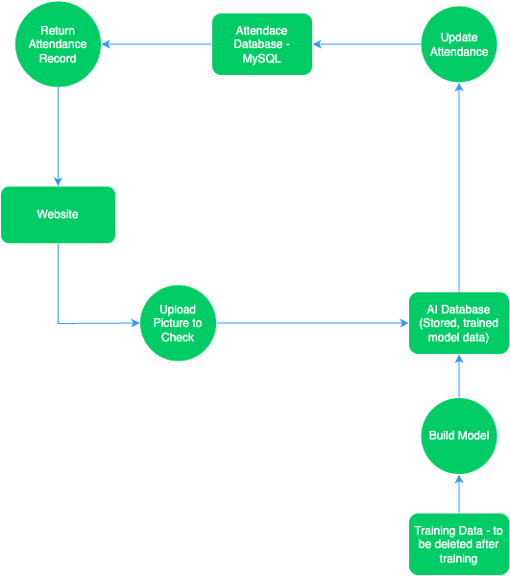
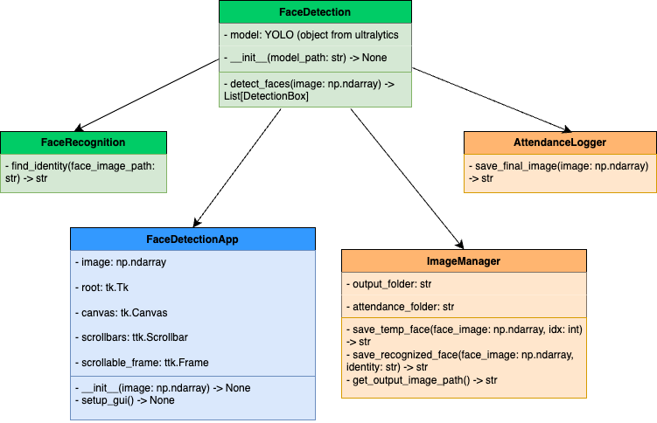
Diagrams Overview
Class Diagram
Sequence Diagram

Slide 10
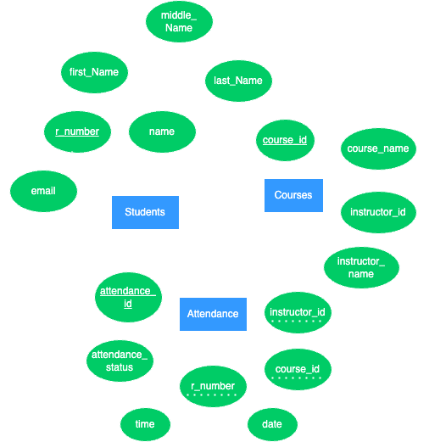
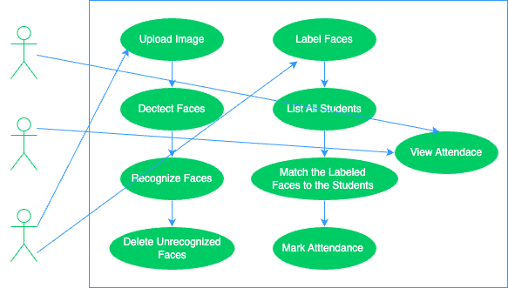
Diagrams Overview
Use Case Diagrams
ER Diagram

Slide 11
MySQL New DatA
-- INSERT into Student
INSERT INTO Students (r_number, first_name, middle_name, last_name, email) VALUES
(11738979, 'Nivedita', 'NULL', 'Prabhu', 'nprabhu@ttu.edu'),
(11669559, 'First6', 'Middle3', 'Last6', 'email6@ttu.edu');
-- INSERT into Courses
INSERT INTO Courses (course_id, course_name, instructor_id, instructor_name) VALUES
(4366, 'Senior Capstone Project', 000000, 'Victor Sheng'), (4366, 'Senior Capstone Project', 000001, 'Nazanin Rahmati'),
(4366, 'Senior Capstone Project', 000002, 'Liyuan Gao'),
(4366, 'Senior Capstone Project', 000003, 'Xin Zhang');
Accurate data
Filler data
Instructor data
Nivedita Prabhu

Slide 12
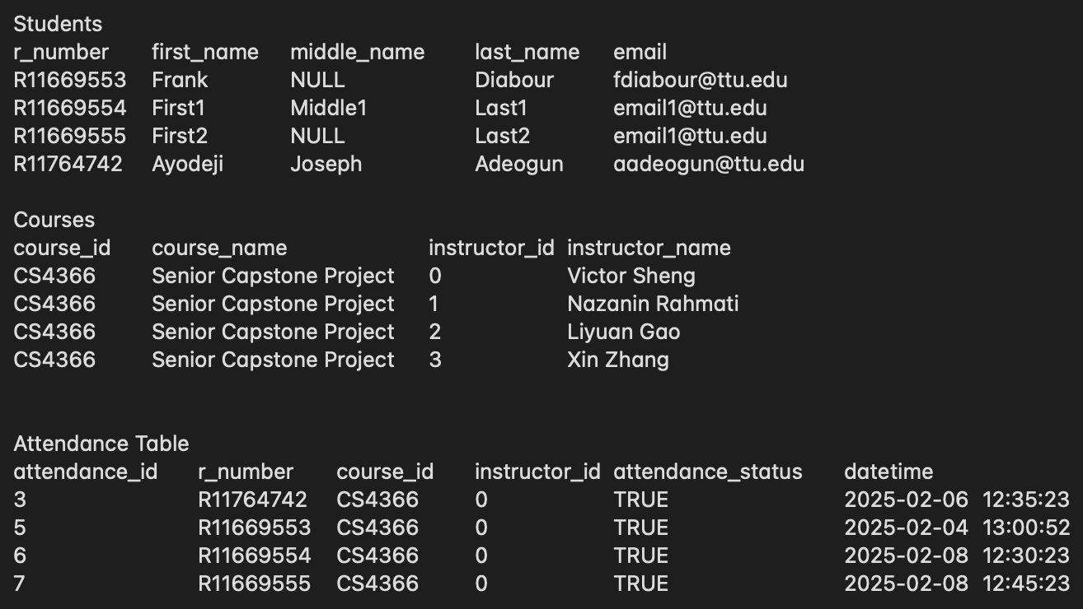
Mysql New Data Output

Slide 13
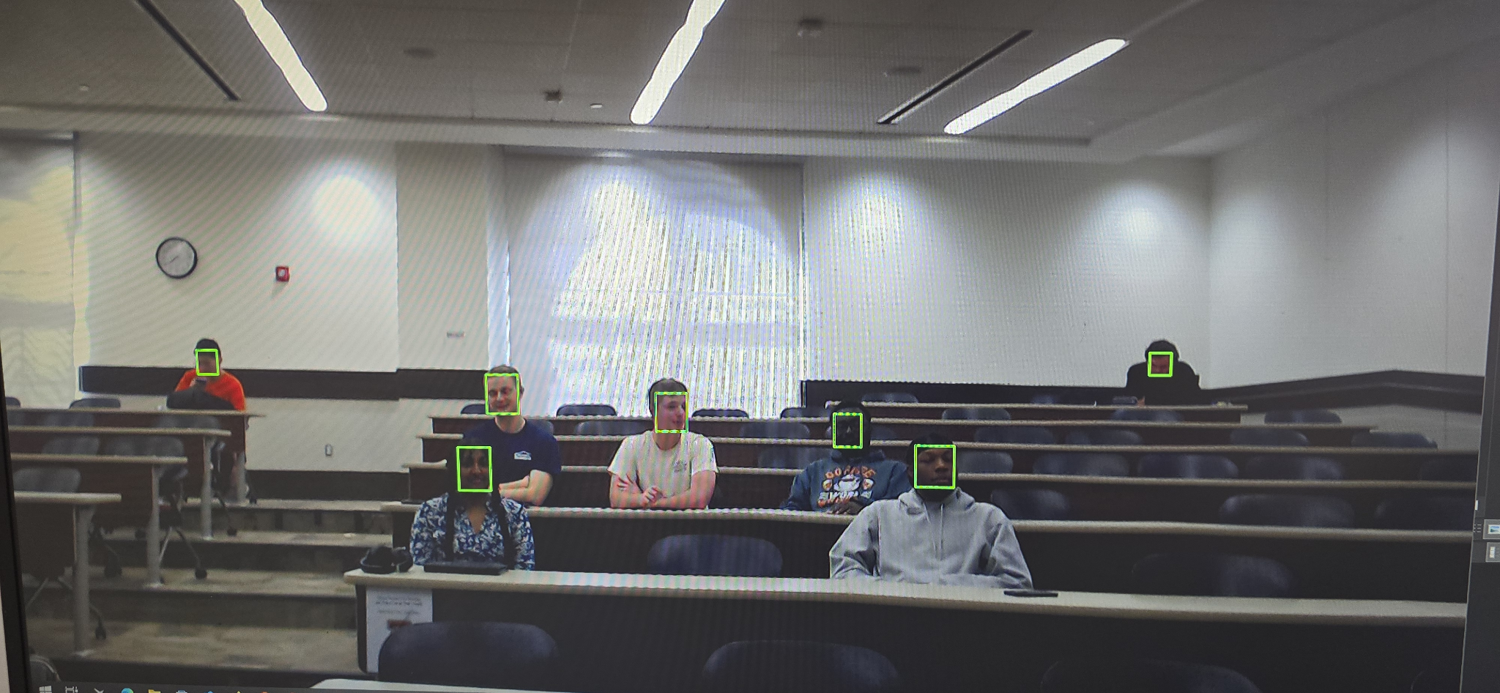
Past Result
STAGE 1 testing

Slide 14
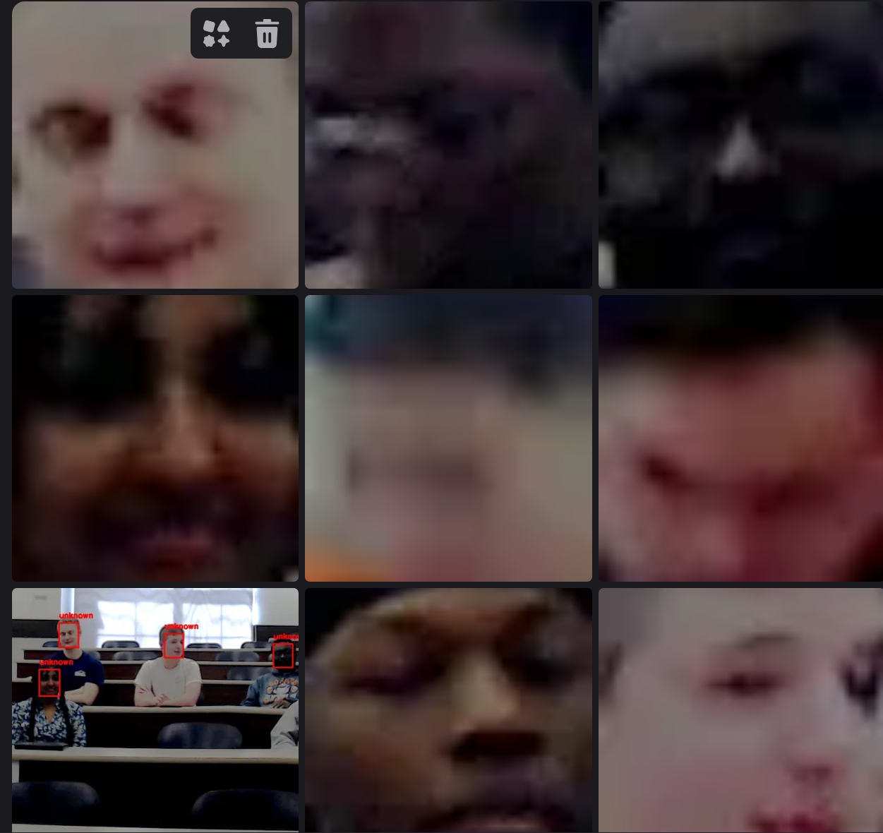
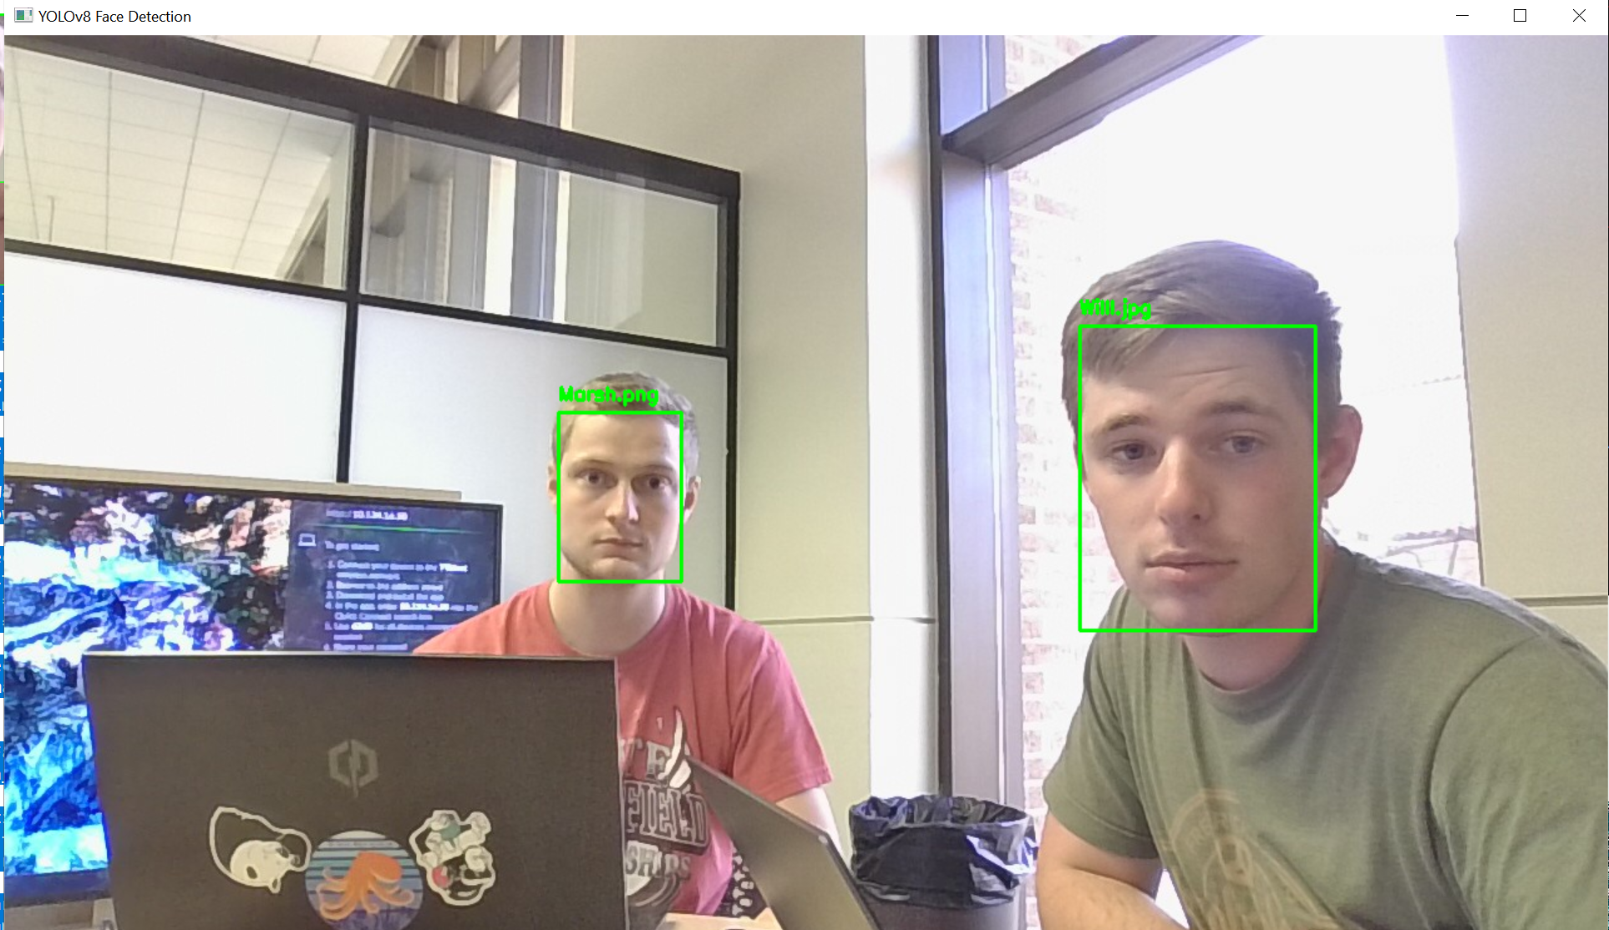
Past rEsults
STAGE 2 testing

Slide 15
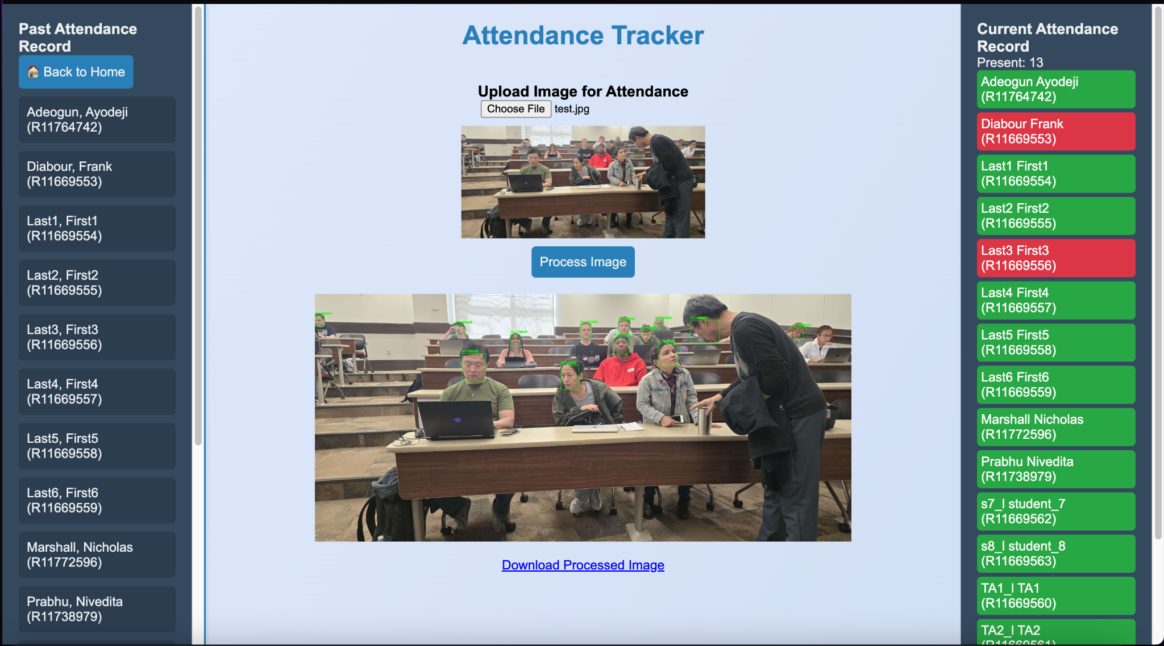
Website Demo
STAGE 3 testing

Slide 16
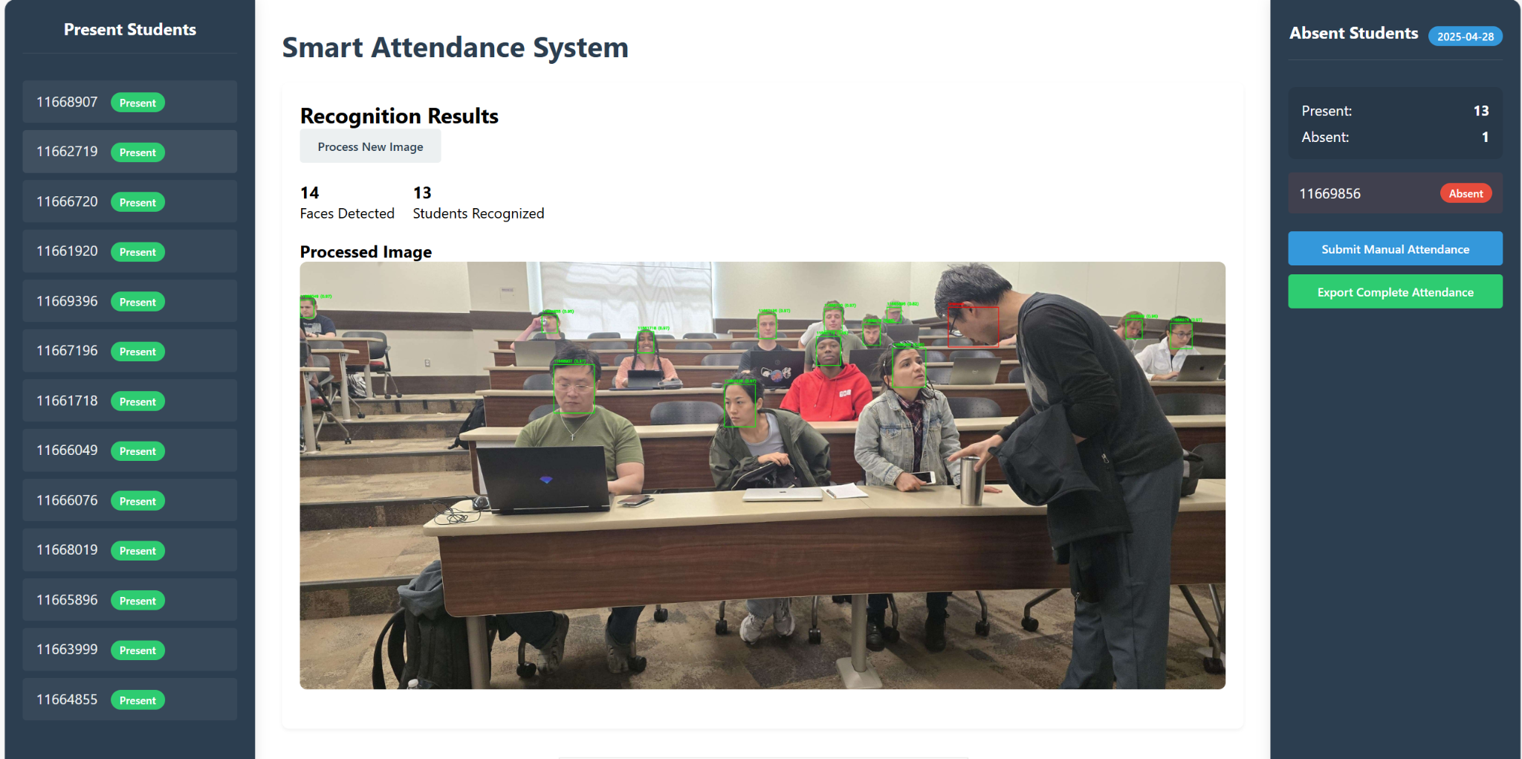
Localhost Demo
STAGE 3 testing

Slide 17
Possible updates
Keep expanding the database with more filler data.
If we were able to add more students to the students, get their info from a student list.
Send an email for notification.
Have the professor to be able to update it in case of missed attendance.
Loading bar, but it doesn’t take long to process the image
Notes:
Update

Slide 18
SUMMARY
Introduction
Motivation
Impacts
Project Implementation
Model Training and Image Augmentation
Data Collection
Diagrams
Database System
Website UI

Slide 19
Thanks!
Q&A

